Slide 1
Unified Conversational Recommendation Policy Learning via Graph-based Reinforcement Learning
(unicorn)

Slide 2


Missing
When to ask/recommend
Scalability
Training Stability
Convergence
DecisionMaking
What to ask
Which to recommend

Slide 3
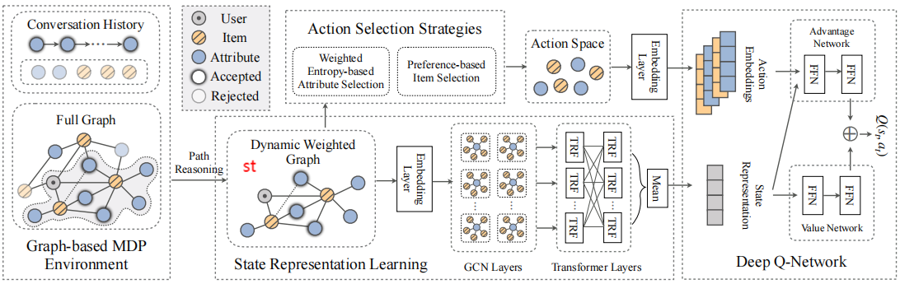
Methodology
Graph-based MDP Environment
Graph-enhanced State Representation Learning
Action Selection Strategy
Deep Q-Learning Network

Slide 4

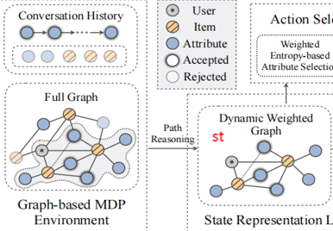

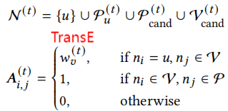
1.Graph-based MDP Environment & Dynamic Weighted Graph Construction

Slide 5
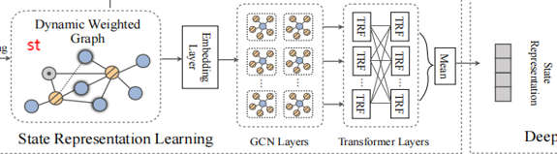



2.Graph-enhanced State Representation Learning

Slide 6
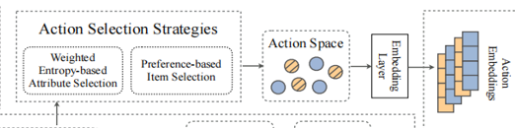



3.Action Selection Strategy

Slide 7
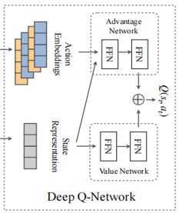


4.Deep Q-Learning Network
Action Selection
ε greedy method a_t
Buffer
Parameter Optimization
Sample a mini-batch with Prioritized Experience Replay

Slide 8
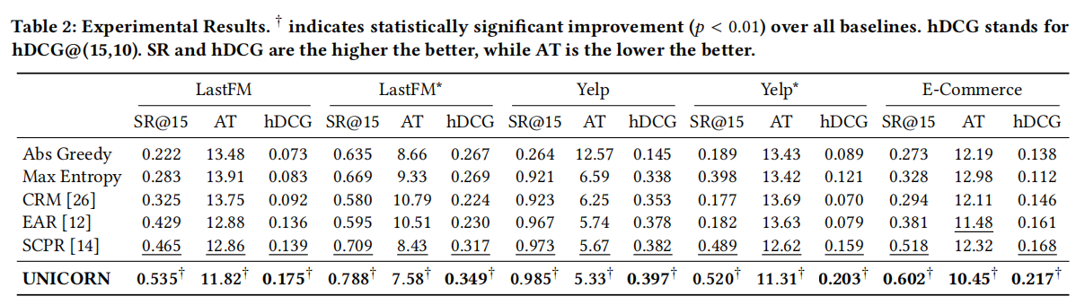
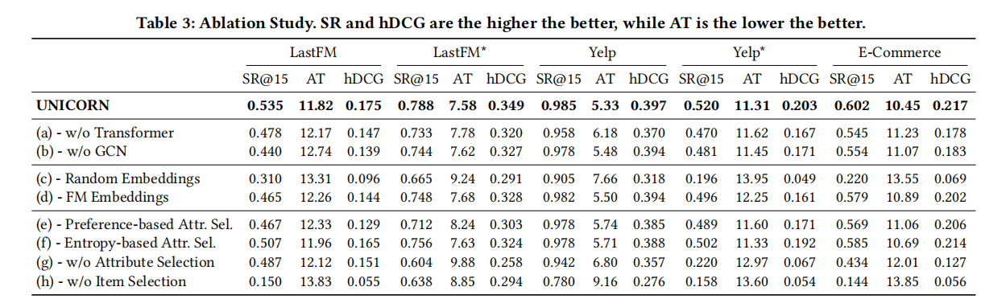
Experimental Results

